Slide 1

ECE 530 Cloud Computing
Ioannis Papapanagiotou
Introduction to Kafka

Slide 2
Kafka
Names comes from the famous German novelist Franz Kafka.
Jay Kreps chose the name as "a system optimized for writing”.
Kafka is publish-subscribe messaging rethought as a distributed commit log.
Kafka Documentation http://kafka.apache.org/
Apache Kafka is based on the commit log, and it allows users to subscribe to it and publish data to any number of systems or real-time applications.
Initially developed by LinkedIn Engineers.
Open Sourced in 2011
LinkedIn decided it was too great and branched it out to a separate company Confluent to continue building (and eventually selling) tools that develop this idea even further.

Slide 3
More on Kafka
Kafka is a distributed messaging system providing fast, highly scalable and redundant messaging through a pub-sub model. Kafka’s distributed design gives it several advantages.
Kafka allows a large number of permanent or ad-hoc consumers.
Kafka is highly available and resilient to node failures and supports automatic recovery.
In real world data systems, these characteristics make Kafka an ideal fit for communication and integration between components of large scale data systems.

Slide 4
Kafka Terminology
The basic architecture of Kafka is organized around a few key terms:
Topics: All Kafka messages are organized into topics.
If you wish to send a message you send it to a specific topic and if you wish to read a message you read it from a specific topic
Producers: producers push messages into a Kafka topic.
Consumers: A consumer of topics pulls messages off of a Kafka topic.
Brokers: Kafka, as a distributed system, runs in a cluster. Each node in the cluster is called a Kafka broker.

Slide 5
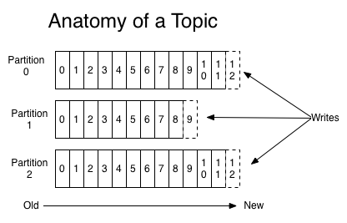
Anatomy of a Kafka Topic
Kafka topics are divided into a number of partitions.
Partitions allow you to parallelize a topic by splitting the data in a particular topic across multiple brokers
Each partition can be placed on a separate machine to allow for multiple consumers to read from a topic in parallel.
Consumers can also be parallelized so that multiple consumers can read from multiple partitions in a topic allowing for very high message processing throughput.

Slide 6
Anatomy of a Kafka Topic (cnt’d)
Each message within a partition has an identifier called its offset.
The offset the ordering of messages as an immutable sequence.
Kafka maintains this message ordering for you.
Consumers can read messages starting from a specific offset and are allowed to read from any offset point they choose, allowing consumers to join the cluster at any point in time they see fit.
Given these constraints, each specific message in a Kafka cluster can be uniquely identified by a tuple consisting of
the message’s topic
partition
offset within the partition.

Slide 7
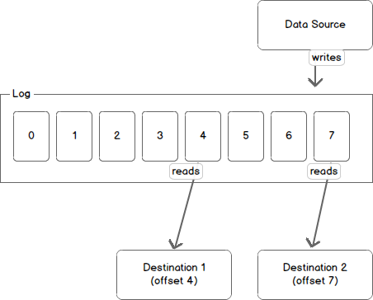
Kafka Partition
Another way to view a partition is as a log.
A data source writes messages to the log and one or more consumers reads from the log at the point in time they choose.
In the diagram below, a data source is writing to the log and consumers A and B are reading from the log at different offsets.
Notes:
Kafka retains messages for a configurable period of time and it is up to the consumers to adjust their behaviour accordingly. For instance, if Kafka is configured to keep messages for a day and a consumer is down for a period of longer than a day, the consumer will lose messages. However, if the consumer is down for an hour it can begin to read messages again starting from its last known offset. From the point of view of Kafka, it keeps no state on what the consumers are reading from a topic.

Slide 8
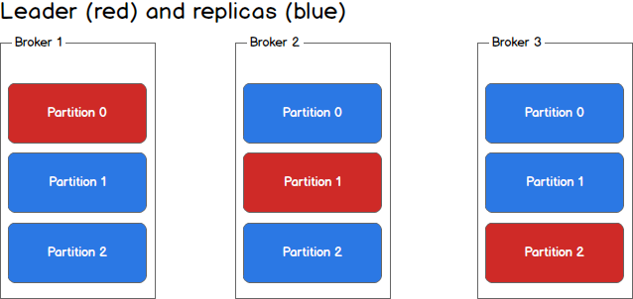
Partitions and Broker
Each broker holds a number of partitions and each of these partitions can be either a leader or a replica for a topic.
All writes and reads to a topic go through the leader and the leader coordinates updating replicas with new data. If a leader fails,
a replica takes over as the new leader.

